Slide 1

User Interface
Wenxuan Shi
College of Software, Nankai University
Email: shiwx@nankai.edu.cn
Wechat: 13920561100

Slide 2
Topics
Introduction to widgets
Building layouts
Notes:
Brand-driven == customized
Internal teams at Google (CRM system) have managed to build functioning prototypes in a week.
Designers with 0 coding experiences became productive with Flutter in weeks - allowing them to build prototypes in hours.

Slide 3
Introduction to widgets https://flutter.dev/docs/development/ui/widgets-intro
Notes:
StatelessWidget is used for immutable elements that only rely on the object configuration information
StatefulWidget is used for elements that can dynamically change based on state-changes in the system
Everytime that state changes, setChange() is called by the object

Slide 4
Introduction
Flutter widgets are built using a modern framework that takes inspiration from React.
The central idea is that you build your UI out of widgets.
Widgets describe what their view should look like given their current configuration and state.
Note: If you would like to become better acquainted with Flutter by diving into some code, check out basic layout codelab, building layouts, and adding interactivity to your Flutter app.

Slide 5
Contents
Hello world
Basic widgets
Using Material Components
Handling gestures
Changing widgets in response to input
Bringing it all together
Responding to widget lifecycle events
Keys
Global Keys
Notes:
Brand-driven == customized
Internal teams at Google (CRM system) have managed to build functioning prototypes in a week.
Designers with 0 coding experiences became productive with Flutter in weeks - allowing them to build prototypes in hours.

Slide 6
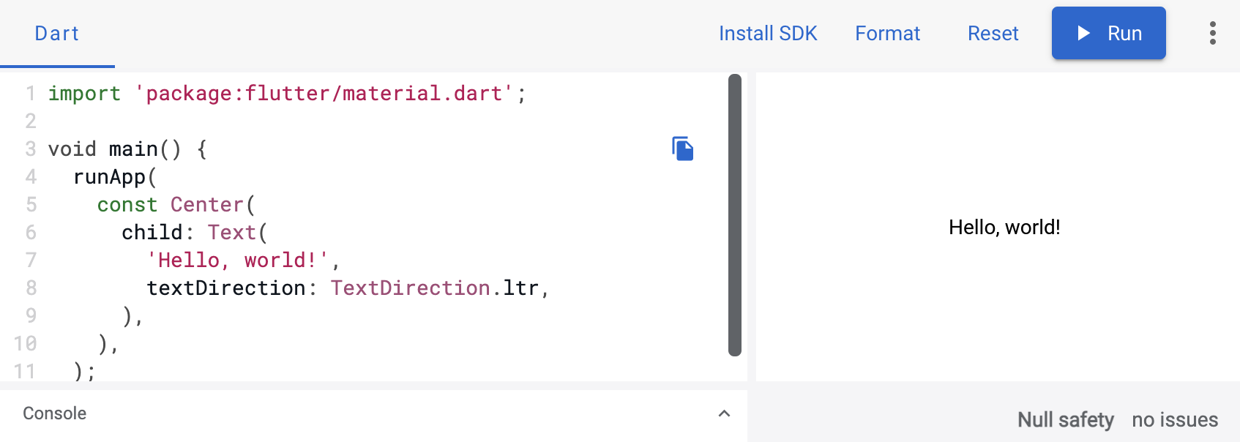
Hello world
The minimal Flutter app simply calls the runApp() function with a widget:
Source Code: ui_widgets/lib/helloworld.dart

Slide 7
Basic widgets
Text: The Text widget lets you create a run of styled text within your application.
Row, Column: These flex widgets let you create flexible layouts in both the horizontal (Row) and vertical (Column) directions. The design of these objects is based on the web’s flexbox layout model.

Slide 8
Stack: Instead of being linearly oriented (either horizontally or vertically), a Stack widget lets you place widgets on top of each other in paint order. You can then use the Positioned widget on children of a Stack to position them relative to the top, right, bottom, or left edge of the stack.
Container: The Container widget lets you create a rectangular visual element. A container can be decorated with a BoxDecoration, such as a background, a border, or a shadow.
Source Code: ui_widgets/lib/container.dart
Notes:
The beauty of hot reload is, that even after fixing an error, state is still maintained - allowing to iterate and develop far quicker.

Slide 9
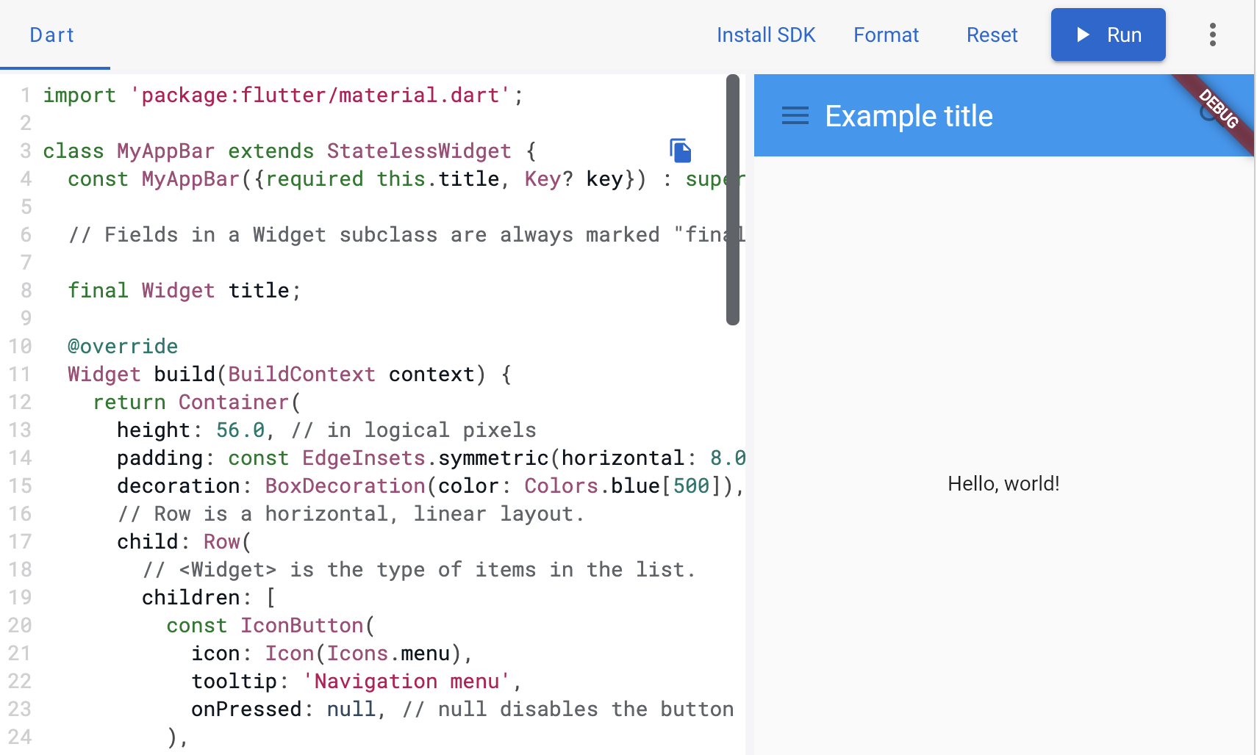
Notes:
Also available via IntelliJ’s built-in debugger

Slide 10
Using Material Components
Flutter provides a number of widgets that help you build apps that follow Material Design.
A Material app starts with the MaterialApp widget, which builds a number of useful widgets at the root of your app, including a Navigator, which manages a stack of widgets identified by strings, also known as “routes”.
Source Code: ui_widgets/lib/material.dart

Slide 11
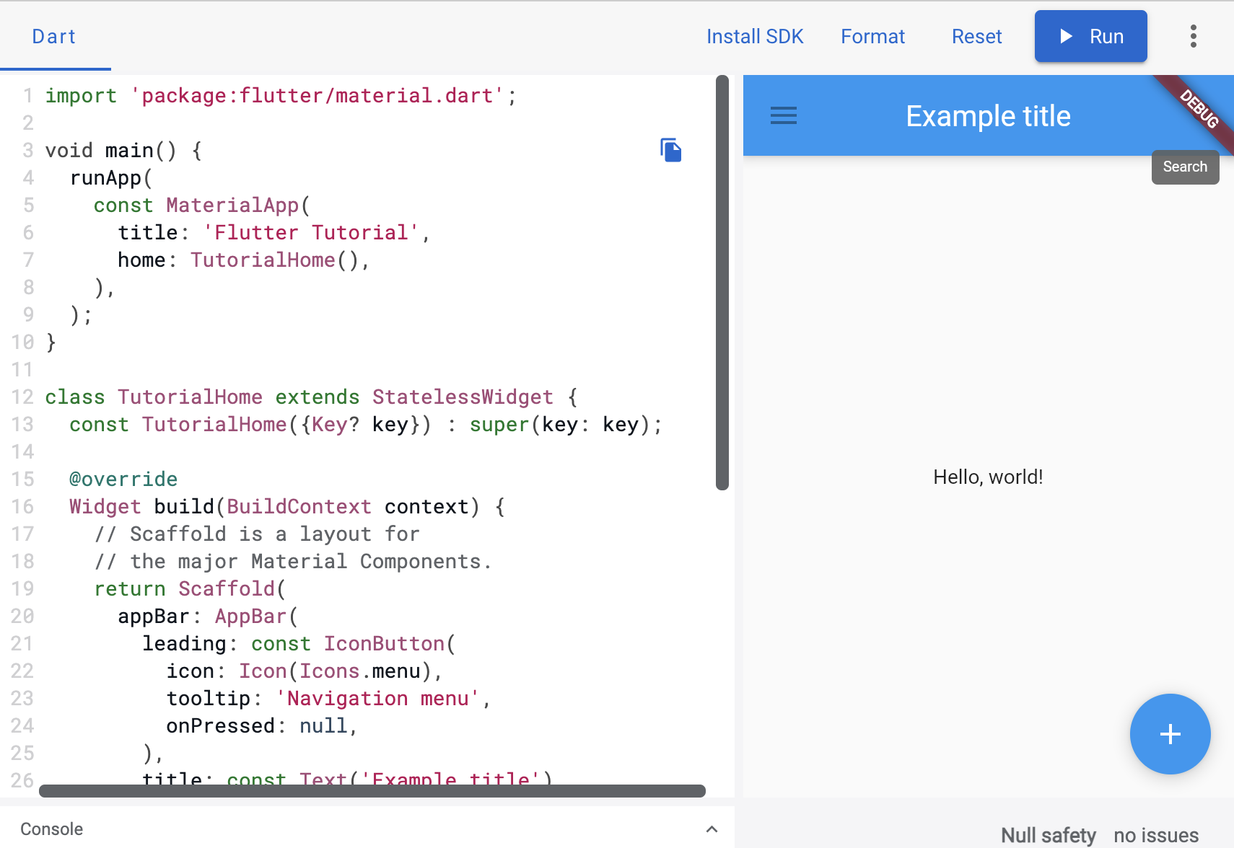

Slide 12
Handling gestures
Most applications include some form of user interaction with the system. The first step in building an interactive application is to detect input gestures.
You can use GestureDetector to detect a variety of input gestures, including taps, drags, and scales.
Source Code: ui_widgets/lib/gestures.dart

Slide 13
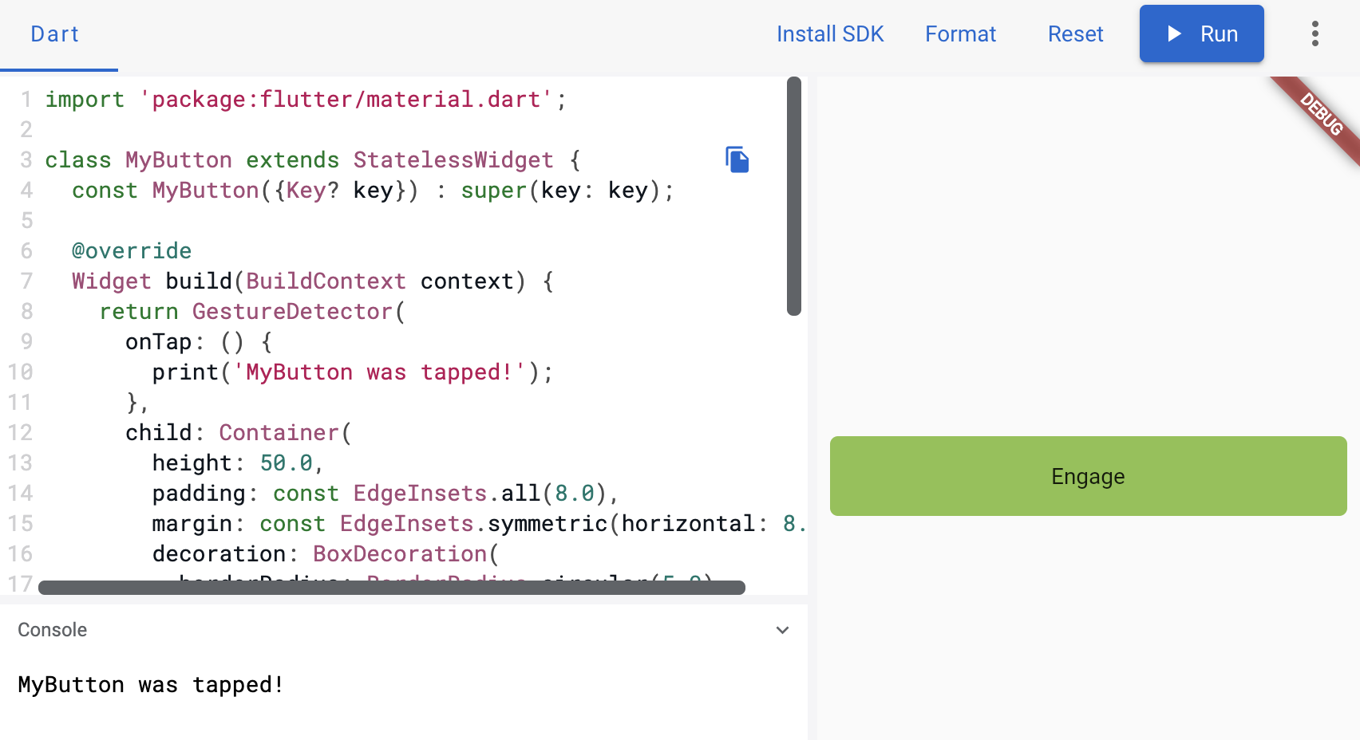

Slide 14
Changing widgets in response to input
In order to build more complex experiences—for example, to react in more interesting ways to user input—applications typically carry some state.
Flutter uses StatefulWidgets to capture this idea.
StatefulWidgets are special widgets that know how to generate State objects, which are then used to hold state.
Source Code: ui_widgets/lib/response.dart

Slide 15
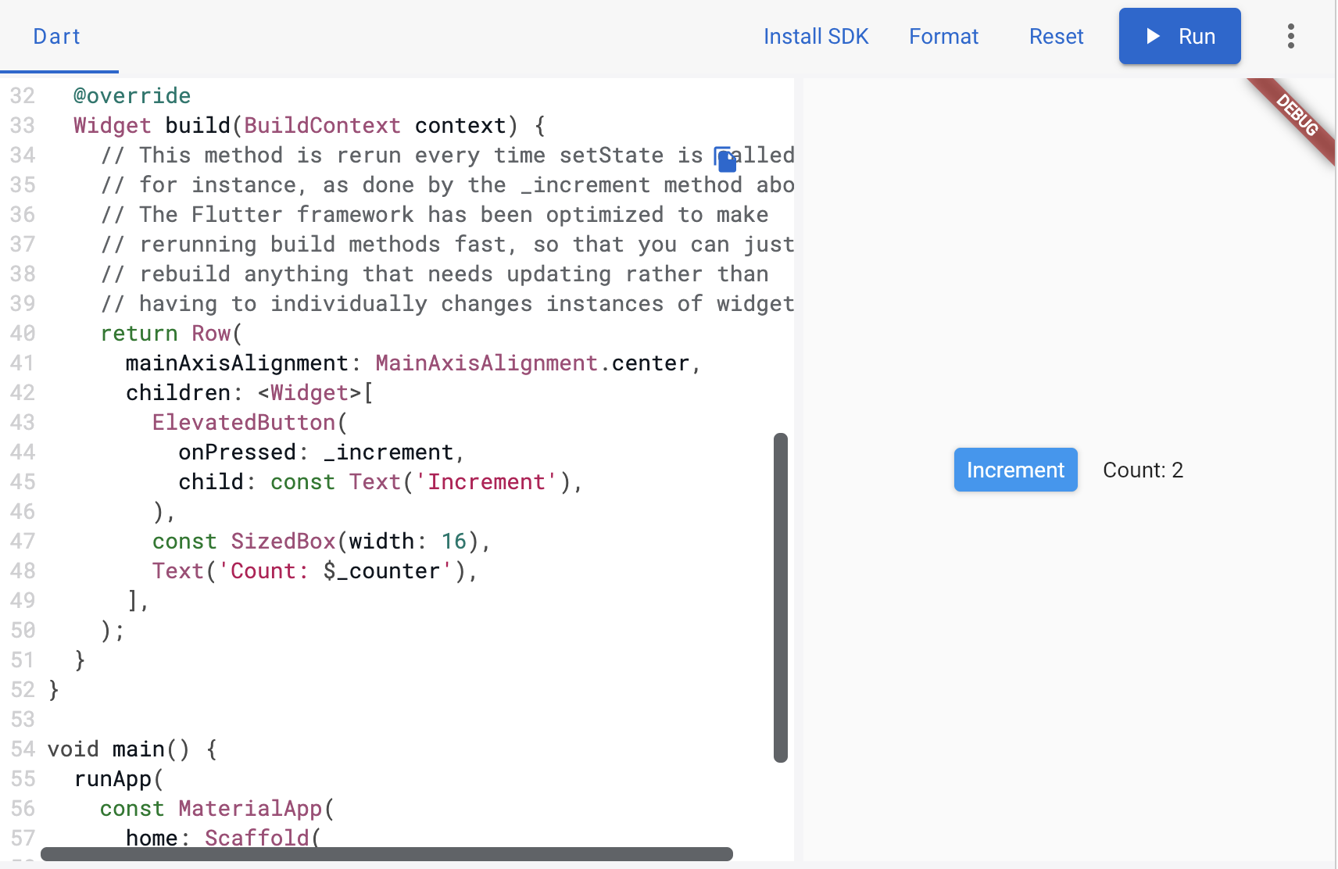

Slide 16
Bringing it all together
What follows is a more complete example that brings together these concepts: A hypothetical shopping application displays various products offered for sale, and maintains a shopping cart for intended purchases.
Source Code: ui_widgets/lib/shoppinglist.dart

Slide 17
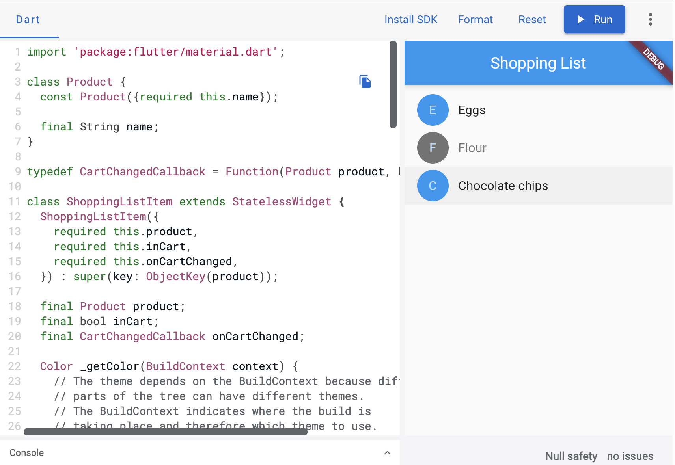

Slide 18
Responding to widget lifecycle events
After calling createState() on the StatefulWidget, the framework inserts the new state object into the tree and then calls initState() on the state object.
A subclass of State can override initState to do work that needs to happen just once.
For example, override initState to configure animations or to subscribe to platform services.

Slide 19
Keys
Use keys to control which widgets the framework matches up with other widgets when a widget rebuilds.
Keys are most useful in widgets that build many instances of the same type of widget.
For example, the ShoppingList widget, which builds just enough ShoppingListItem instances to fill its visible region.

Slide 20
Global Keys
Use global keys to uniquely identify child widgets.
Global keys must be globally unique across the entire widget hierarchy, unlike local keys which need only be unique among siblings.
Because they are globally unique, a global key can be used to retrieve the state associated with a widget.

Slide 21
Building Layouts https://flutter.dev/docs/development/ui/layout
Notes:
StatelessWidget is used for immutable elements that only rely on the object configuration information
StatefulWidget is used for elements that can dynamically change based on state-changes in the system
Everytime that state changes, setChange() is called by the object

Slide 22
What's the point?
Widgets are classes used to build UIs.
Widgets are used for both layout and UI elements.
Compose simple widgets to build complex widgets.
Here’s a diagram of the widget tree for this UI:

Slide 23
Lay out a widget
How do you layout a single widget in Flutter? This section shows you how to create and display a simple widget. It also shows the entire code for a simple Hello World app.
In Flutter, it takes only a few steps to put text, an icon, or an image on the screen.

Slide 24
1. Select a layout widget
Choose from a variety of layout widgets based on how you want to align or constrain the visible widget, as these characteristics are typically passed on to the contained widget.
This example uses Center which centers its content horizontally and vertically.

Slide 25
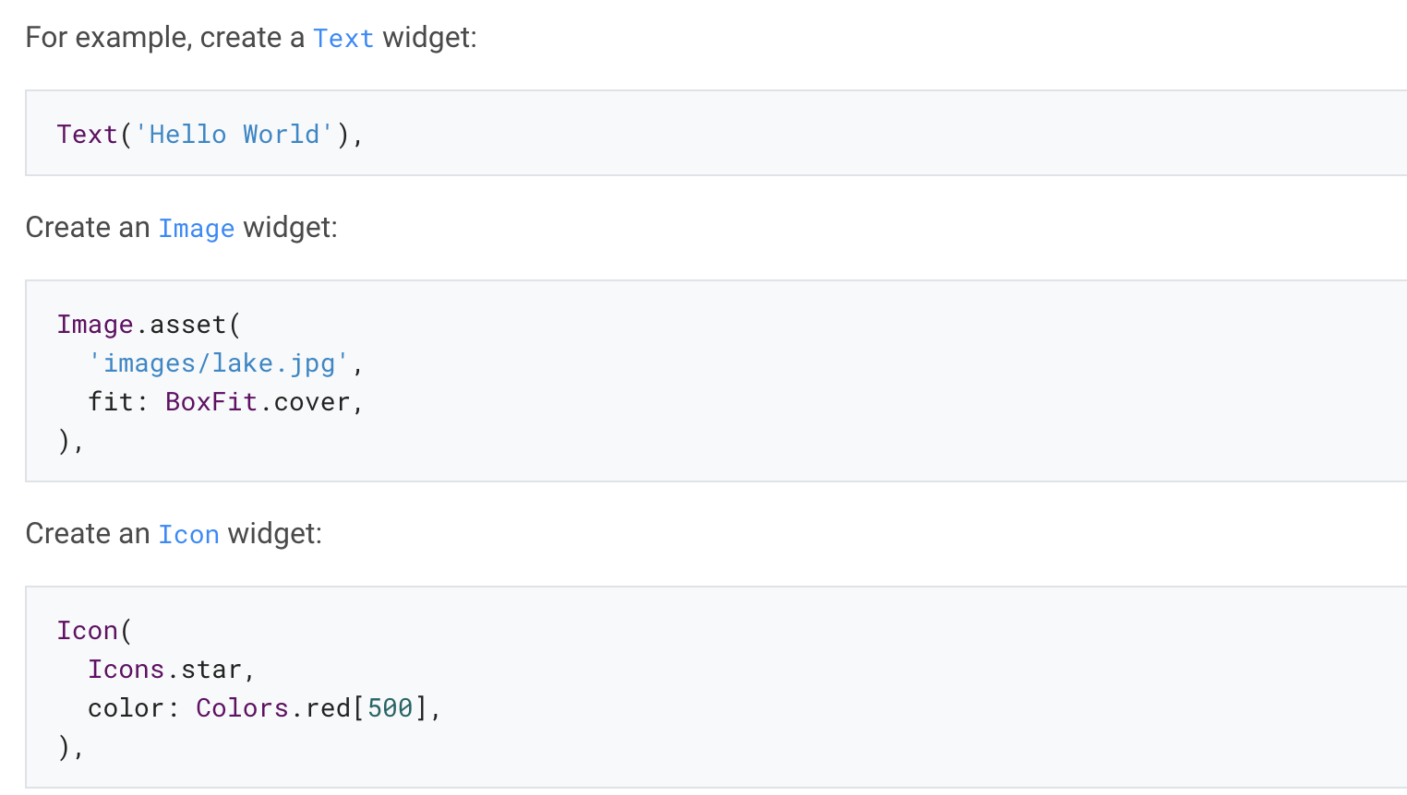
2. Create a visible widget

Slide 26
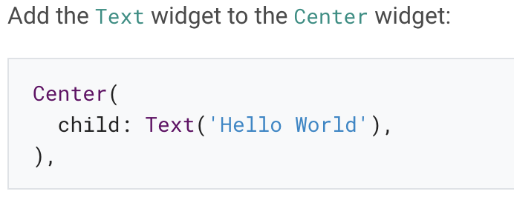
3. Add the visible widget to the layout widget
All layout widgets have either of the following:
A child property if they take a single child – for example, Center or Container
A children property if they take a list of widgets – for example, Row, Column, ListView, or Stack.

Slide 27
4. Add the layout widget to the page
A Flutter app is itself a widget, and most widgets have a build() method. Instantiating and returning a widget in the app’s build() method displays the widget.

Slide 28
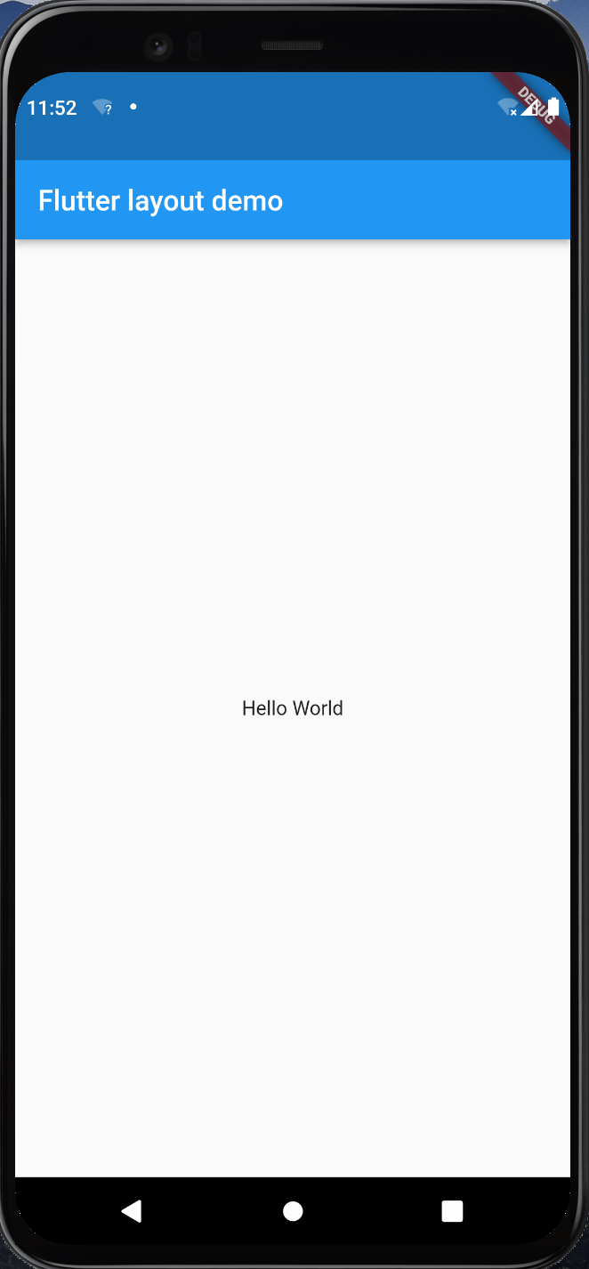
Material apps
For a Material app, you can use a Scaffold widget; it provides a default banner, background color, and has API for adding drawers, snack bars, and bottom sheets.
Source Code: ui_widgets/lib/layout_material.dart

Slide 29
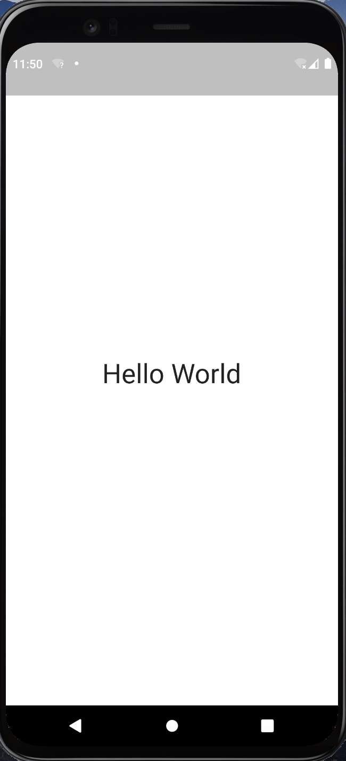
Non-Material apps
For a non-Material app, you can add the Center widget to the app’s build() method.
Source Code: ui_widgets/lib/layout_non_material.dart

Slide 30
Lay out multiple widgets vertically and horizontally
What's the point?
Row and Column are two of the most commonly used layout patterns.
Row and Column each take a list of child widgets.
A child widget can itself be a Row, Column, or other complex widget.
You can specify how a Row or Column aligns its children, both vertically and horizontally.
You can stretch or constrain specific child widgets.
You can specify how child widgets use the Row’s or Column’s available space.

Slide 31
This layout is organized as a Row.
The row contains two children: a column on the left, and an image on the right:

Slide 32
The left column’s widget tree nests rows and columns.

Slide 33
Aligning widgets
You control how a row or column aligns its children using the mainAxisAlignment and crossAxisAlignment properties.

Slide 34
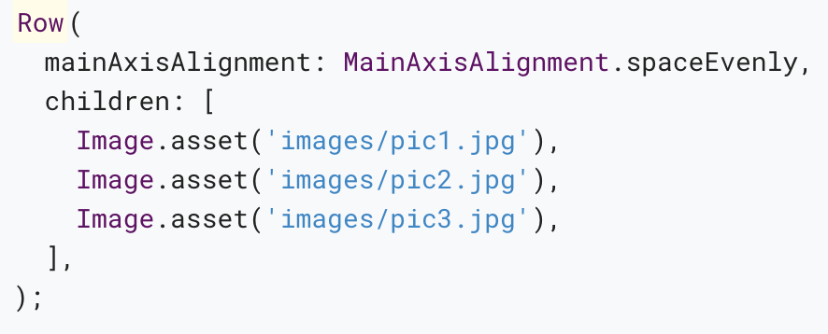
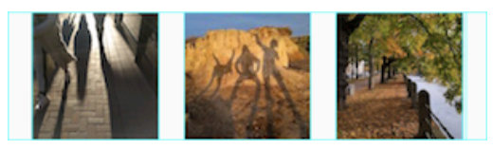
In the following example, each of the 3 images is 100 pixels wide.
App source: row_column

Slide 35
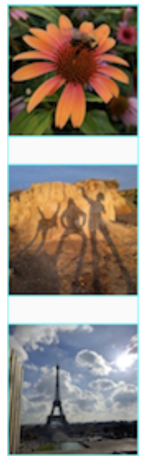
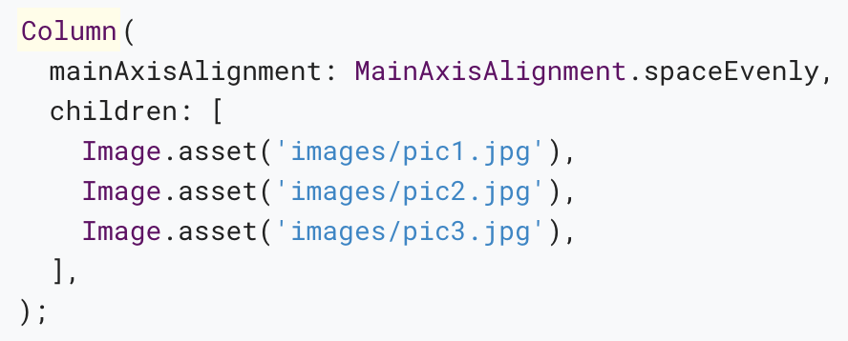
The following example shows a column of 3 images, each is 100 pixels high.
App source: row_column

Slide 36
Sizing widgets
When a layout is too large to fit a device, a yellow and black striped pattern appears along the affected edge.
Here is an example of a row that is too wide:

Slide 37
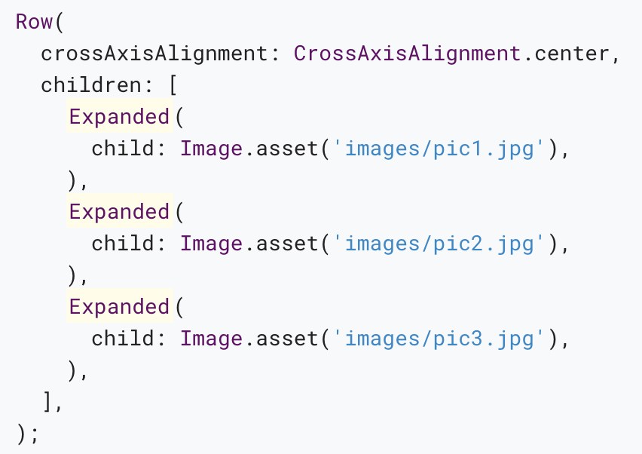
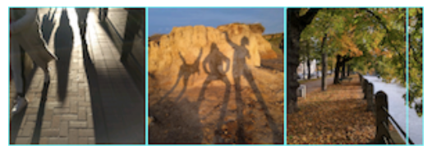
Widgets can be sized to fit within a row or column by using the Expanded widget.
App source: sizing

Slide 38
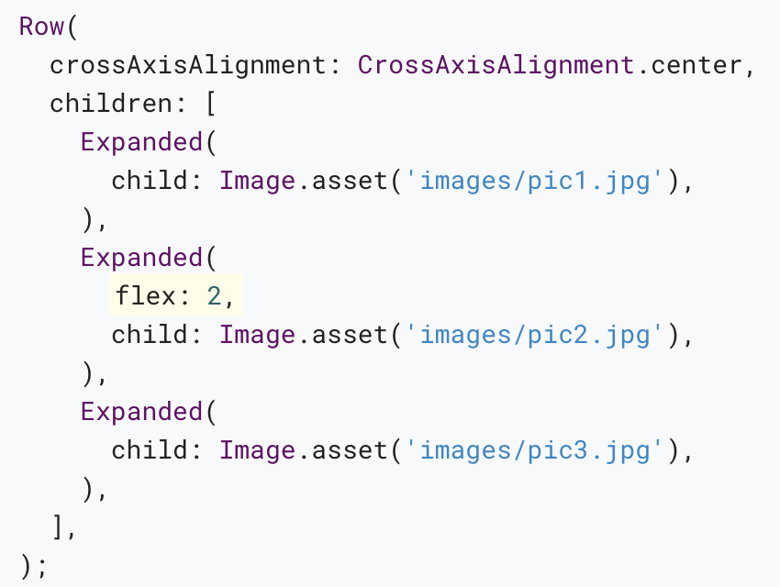
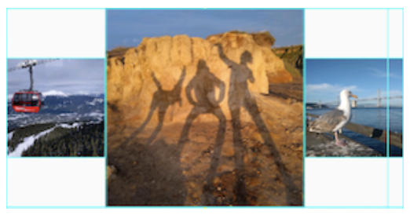
Perhaps you want a widget to occupy twice as much space as its siblings.
App source: sizing

Slide 39
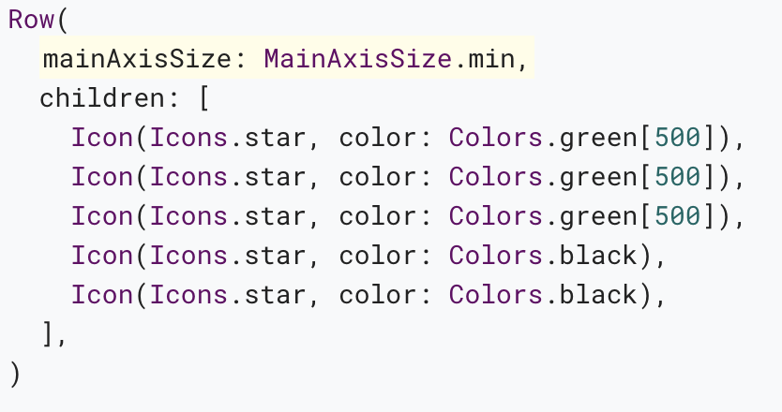
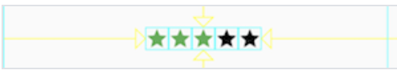
Packing widgets
By default, a row or column occupies as much space along its main axis as possible, but if you want to pack the children closely together, set its mainAxisSize to MainAxisSize.min.
App source: pavlova

Slide 40
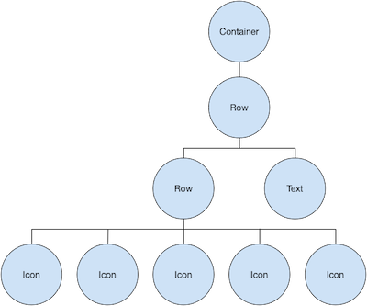
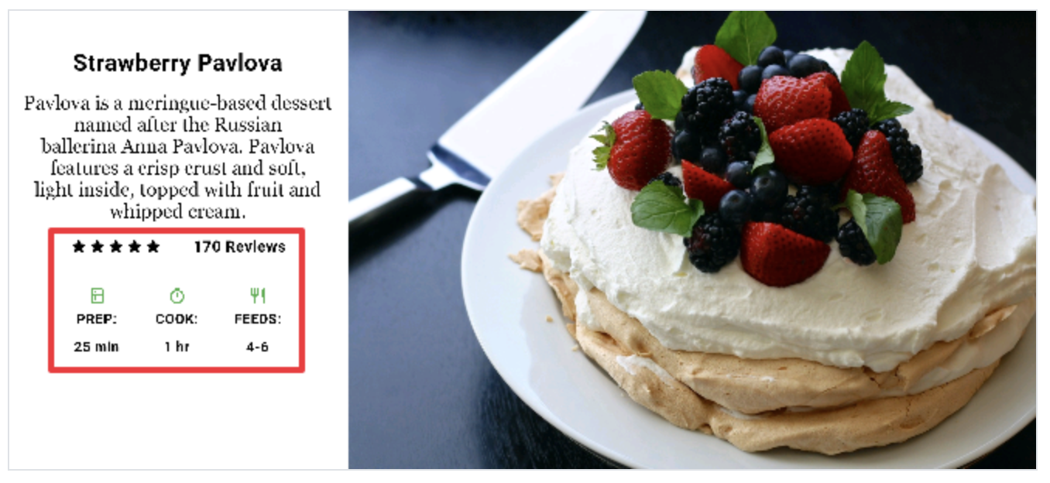
Nesting rows and columns
The layout framework allows you to nest rows and columns inside of rows and columns as deeply as you need.
App source: pavlova
The widget tree for the ratings row:

Slide 41
Common layout widgets
Flutter has a rich library of layout widgets.
The following widgets fall into two categories: standard widgets from the widgets library, and specialized widgets from the Material library.

Slide 42
Standard widgets
Container: Adds padding, margins, borders, background color, or other decorations to a widget.
GridView: Lays widgets out as a scrollable grid.
ListView: Lays widgets out as a scrollable list.
Stack: Overlaps a widget on top of another.

Slide 43
Material widgets
Card: Organizes related info into a box with rounded corners and a drop shadow.
ListTile: Organizes up to 3 lines of text, and optional leading and trailing icons, into a row.

Slide 44
Container
Add padding, margins, borders
Change background color or image
Contains a single child widget, but that child can be a Row, Column, or even the root of a widget tree

Slide 45
Examples (Container)
This layout consists of a column with two rows, each containing 2 images.
App source: container

Slide 46
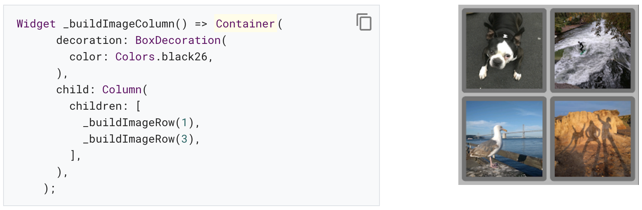
A Container is used to change the background color of the column to a lighter grey.

Slide 47
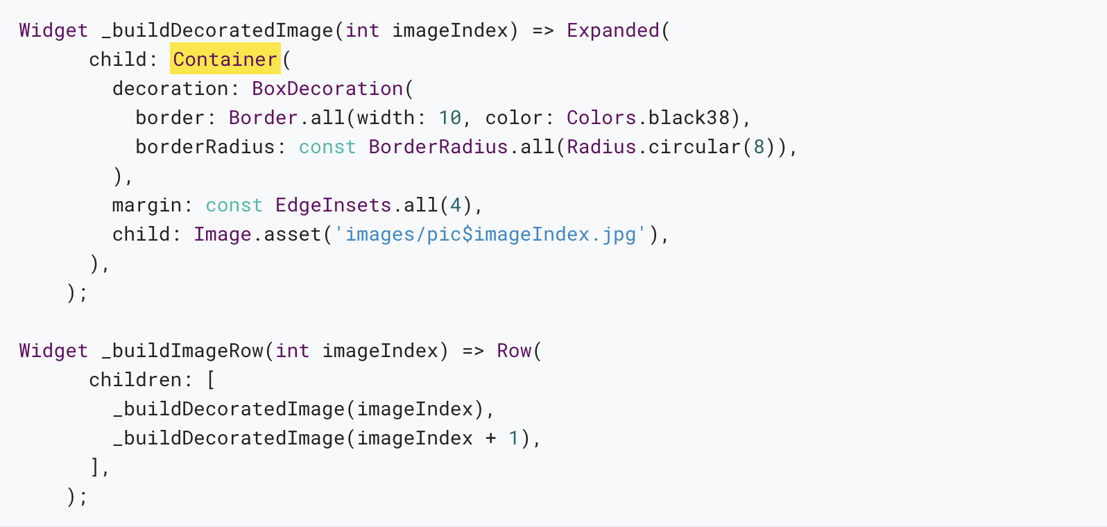
A Container is also used to add a rounded border and margins to each image:

Slide 48
GridView
Lays widgets out in a grid
Detects when the column content exceeds the render box and automatically provides scrolling
Build your own custom grid, or use one of the provided grids:
GridView.count allows you to specify the number of columns
GridView.extent allows you to specify the maximum pixel width of a tile

Slide 49
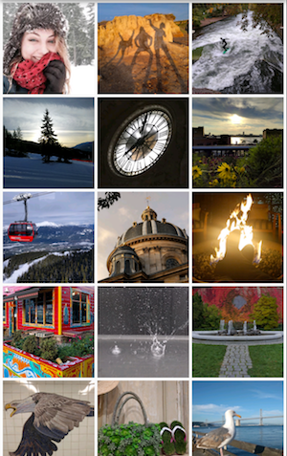
Examples (GridView)
Uses GridView.extent to create a grid with tiles a maximum 150 pixels wide.
App source: grid_and_list

Slide 50
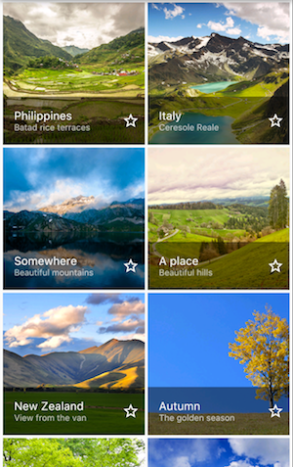
Examples (GridView)
Uses GridView.count to create a grid that’s 2 tiles wide in portrait mode, and 3 tiles wide in landscape mode.
Dart code: grid_list_demo.dart from the Flutter Gallery

Slide 51
ListView
A specialized Column for organizing a list of boxes
Can be laid out horizontally or vertically
Detects when its content won’t fit and provides scrolling
Less configurable than Column, but easier to use and supports scrolling

Slide 52
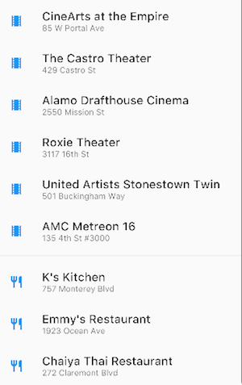
Examples (ListView)
Uses ListView to display a list of businesses using ListTiles.
A Divider separates the theaters from the restaurants.
App source: grid_and_list

Slide 53
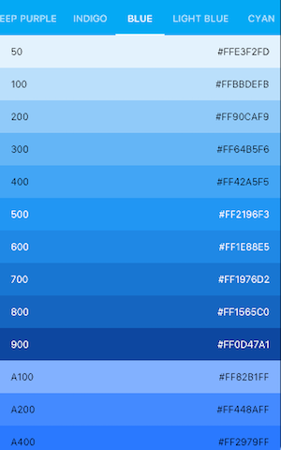
Examples (ListView)
Uses ListView to display the Colors from the Material Design palette for a particular color family.
Dart code: colors_demo.dart from the Flutter Gallery

Slide 54
Stack
Use for widgets that overlap another widget
The first widget in the list of children is the base widget; subsequent children are overlaid on top of that base widget
A Stack’s content can’t scroll
You can choose to clip children that exceed the render box

Slide 55

Examples (Stack)
Uses Stack to overlay a Container (that displays its Text on a translucent black background) on top of a CircleAvatar.
App source: card_and_stack
static const showCard = false; // Set to false to show Stack

Slide 56
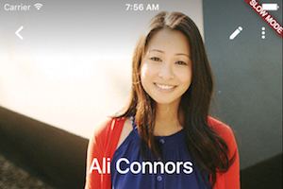
Examples (Stack)
Uses Stack to overlay a gradient to the top of the image. The gradient ensures that the toolbar’s icons are distinct against the image.
Dart code: contacts_demo.dart from the Flutter Gallery

Slide 57
Card
Implements a Material card
Used for presenting related nuggets of information
Accepts a single child, but that child can be a Row, Column, or other widget that holds a list of children
Displayed with rounded corners and a drop shadow
A Card’s content can’t scroll
From the Material library

Slide 58
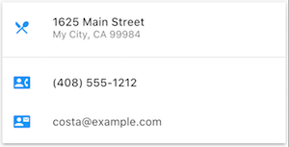
Examples (Card)
A Card containing 3 ListTiles and sized by wrapping it with a SizedBox.
A Divider separates the first and second ListTiles.
App source: card_and_stack
static const showCard = true;

Slide 59
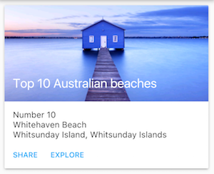
Examples (Card)
A Card containing an image and text.
Dart code: cards_demo.dart from the Flutter Gallery

Slide 60
ListTile
A specialized row that contains up to 3 lines of text and optional icons
Less configurable than Row, but easier to use
From the Material library

Slide 61
Examples (ListTile)
A Card containing 3 ListTiles.
App source: card_and_stack

Slide 62
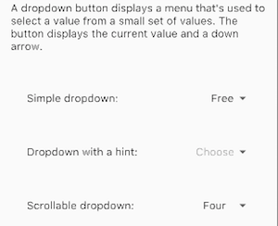
Examples (ListTile)
Uses ListTile to list 3 drop down button types.
Dart code: buttons_demo.dart from the Flutter Gallery

Slide 63
Other resources
Layout tutorial: Learn how to build a layout.
Widget Overview: Describes many of the widgets available in Flutter.
HTML/CSS Analogs in Flutter: For those familiar with web programming, this page maps HTML/CSS functionality to Flutter features.
Flutter Gallery: Demo app showcasing many Material Design widgets and other Flutter features.
Flutter API documentation: Reference documentation for all of the Flutter libraries.
Dealing with Box Constraints in Flutter: Discusses how widgets are constrained by their render boxes.
Adding Assets and Images in Flutter: Explains how to add images and other assets to your app’s package.
Zero to One with Flutter: One person’s experience writing his first Flutter app.

Slide 64
Thank you!
Wenxuan Shi
College of Software, Nankai University
Email: shiwx@nankai.edu.cn
Wechat: 13920561100

